Slide 1



SASS
Syntactically Awesome Stylesheets

Slide 2
Table of Contents
SASS Overview
Working with SASS
Using Ruby Console
Using Visual Studio Plugins
SASS Features
Nesting
Variables
Mixins
Selector Inheritance

Slide 3

SASS Overview
What is SASS?

Slide 4
SASS Overview
Syntactically Awesome Stylesheets is an extension of CSS
Makes coding CSS much easier and organized
Translates to pure CSS on the server
i.e. no slowdown on the client
SASS introduces many techniques to power the CSS coding
Variables
Functions ( i.e. Mixins)

Slide 5

Working with SASS
Ok… but How?

Slide 6
Coding SASS Using PERL
Using Ruby and Ruby console
Install Ruby
Run Ruby command prompt
Set Ruby to listen for changes on the SASS file
Open the SASS file with any text editor
You get the translated CSS

Slide 7

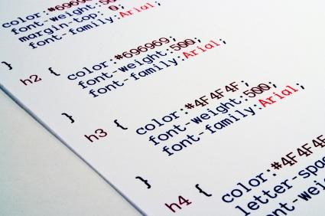
Coding SASS Using Ruby
Live Demo

Slide 8
Coding SASS in Visual Studio
VS has many plugins to support SASS
Web Workbench
Web Essentials (soon)
How to install plugins?
Go to http://visualstudiogallery.msdn.microsoft.com and find the plugin
Open VS -> Tools -> Extensions and Updates -> find the plugin
Create SCSS file and do your SASS

Slide 9
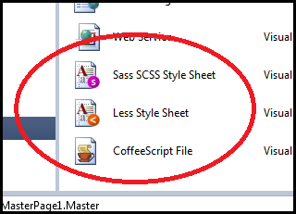
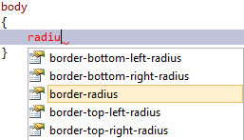
SASS in Visual Studio
Live Demo

Slide 10

SASS Features
Selector Nesting, Mixins, Variables, etc…

Slide 11
Selector Nesting
With SASS introduces selector nesting
body {
font: normal 16px arial;
color: #fff;
background-color: #011b63;
h1 {
font-size: 2.3em;
font-weight: bold;
}
}
body {
font: normal 16px arial;
color: #fff;
background-color: #011b63;
}
body h1 {
font-size: 2.3em;
font-weight: bold;
}
Translates to

Slide 12
Selector Nesting (2)
All selectors inside a selector are translated to nested selectors
Selectors can also reference themselves inside their selector using the symbol & (AND)
body {…
h1 {…}
}
body {…}
body h1{…}
…
a{
&:hover{…}
}
…
…
a{…}
a:hover{…}
…

Slide 13
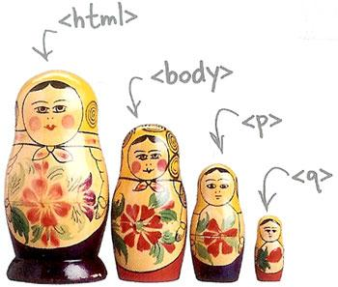
Selector Nesting
Live Demo

Slide 14
SASS Variables
SASS also has variables
Using the $ (dolar) symbol
Can be used to store colors, size, etc…
Usable to set default background-color, font-color, font-size, etc…
$link-color: #ffffff;
$v-link-color: #646363;
a {
color: $link-color;
&:visited {
color: $v-link-color;
}
body a {
color: white; }
body a:visited {
color: #646363; }

Slide 15

Variables
Live Demo

Slide 16
Interpolation
SASS variables can be inserted as CSS properties
Using #{}
$border-side:top;
$border-color:blue;
$border-style:ridge;
$border-width:15px;
…
border-#{$border-side} :
$border-width $border-style $border-color;
border-top : 15px ridge blue

Slide 17
Interpolation
Live Demo

Slide 18
Mixins
Mixins are kind of developer defined functions
The developer can make them for clear SASS
Two kind of mixins
Parameterless
Get a default styles every time
With parameters
Get style based on some parameters
Gradient, borders, etc…

Slide 19
Mixins (2)
How to define mixins?
Use @mixin mixin-name
Then the styles are normal SASS
How to use the mixin?
Place use @include mixin-name
@mixin clearfix{
zoom:1;
&:after{
display:block; content:"";
height:0; clear:both; } }
ul#main-nav{
@include clearfix;
}

Slide 20

Basic Mixins
Live Demo

Slide 21
Mixins with Arguments
Mixins can also be defined with parameters
i.e. for gradient-background
Put the arguments like a C# or JavaScript method
@mixin opacity($value){
opacity:$value;
filter: alpha(opacity=($value*100));
zoom:1;
}
//arguments can take default values
@mixin box($border:none,$bg:rgba(0,0,0,0.7),$size:200px) {
width:$size; height:$size;
border:$border;
background:$bg;
padding:15px;
}

Slide 22

Mixins with Arguments
Live Demo

Slide 23
Selector Inheritance
SASS enables the inheritance of selector
i.e. in a selector, get the properties of another selector
Use @extend
.clearfix {
zoom: 1;
&:after {
display: block; height: 0;
content: ""; clear: both;
}
}
div{
@extend .clearfix; }
.clearfix, body div {
zoom: 1;
}
.clearfix:after, body div:after {
display: block;
height: 0;
content: "";
clear: both;
}

Slide 24
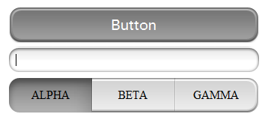
Selector Inheritance
Live Demo

Slide 25
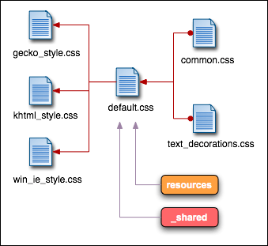
Importing SASS

Slide 26
Importing SASS Files
SASS files can be imported in other SASS files
Like CSS files can be imported in CSS files
Use the @import directive
SASS defines partials
i.e. SASS files that are meant to be imported
Just use prefix _ (underscope)
@import 'gradients.scss'
//can use the items from gradients.scss

Slide 27

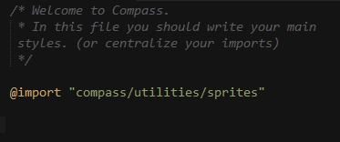
Importing SASS
Live Demo

Slide 28
SASS
http://academy.Telerik.com

Slide 29
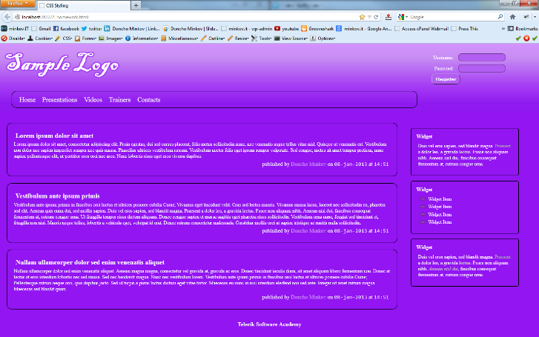
Homework
Implement the following using either LESS or SASS
Use the HTML code from homework.html
Create the LESS/SASS easy to change (colors, fonts)
Use mixins for clears, gradients)
Source can be found in Preprocessors-homework.zip

Slide 30
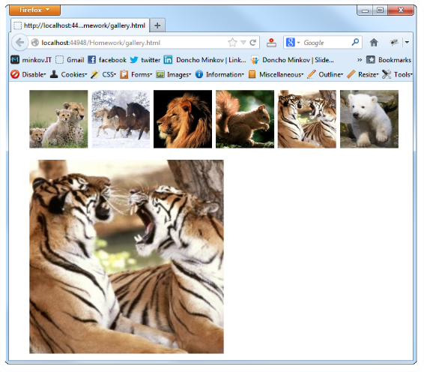
Homework (2)
Create a web gallery
Use only HTML, LESS or SASS
List images
When a image is selected, show it zoomed

